Slide 1
ASSET MANAGEMENT TOOLS FOR SECURITY FUNCTIONS
Asset management helps with the following security functions:
Patch management
Software whitelisting
Software assets discovery and management
Enterprise tracking and reporting

Slide 2
ASSET MANAGEMENT TOOLS FOR SECURITY FUNCTIONS
Gartner refers to this area as Unified endpoint management (UEM):

Slide 3
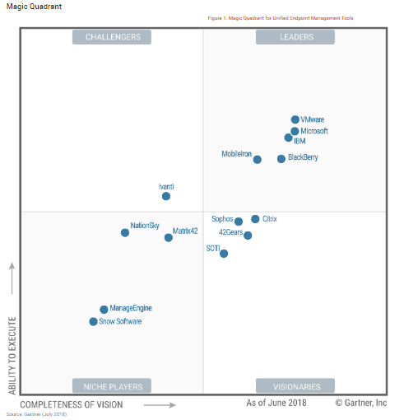
ASSET MANAGEMENT TOOLS FOR SECURITY FUNCTIONS
GARTNER MAGIC QUADRANT FOR
UNIFIED ENDPOINT MANAGEMENT 2018

Slide 4
ASSET MANAGEMENT TOOLS FOR SECURITY FUNCTIONS
Unified endpoint management (UEM) tools combine the management of multiple endpoint types in a single console. UEM tools perform the following functions:
GARTNER UEM 2018 REPORT

Slide 5
ASSET MANAGEMENT TOOLS FOR SECURITY FUNCTIONS
Configure, manage and monitor iOS, Android, Windows 10 and macOS, and manage some Internet of Things (IoT) and wearable endpoints.
Unify the application of configurations, management profiles, device compliance and data protection.

Slide 6
ASSET MANAGEMENT TOOLS FOR SECURITY FUNCTIONS
3. Provide a single view of multidevice users, enhancing efficacy of end-user support and gathering detailed workplace analytics.
4. Act as a coordination point to orchestrate the activities of related endpoint technologies such as identity services and security infrastructure.

Slide 7
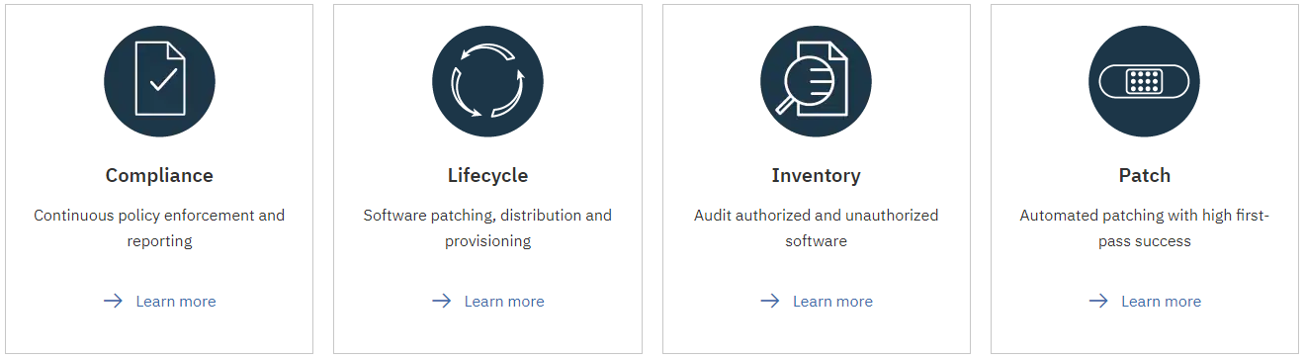
ASSET MANAGEMENT TOOLS FOR SECURITY FUNCTIONS
https://www.ibm.com/security/endpoint-security/bigfix

Slide 8
ASSET MANAGEMENT TOOLS FOR SECURITY FUNCTIONS
MICROSOFT SOFTWARE RESTRICTION POLICIES (SRP) FOR WHITELISTING
Software Restriction Policies (SRP) is Group Policy-based feature that identifies software programs running on computers in a domain, and controls the ability of those programs to run.

Slide 9
ASSET MANAGEMENT TOOLS FOR SECURITY FUNCTIONS
…Software restriction policies are part of the Microsoft security and management strategy to assist enterprises in increasing the reliability, integrity, and manageability of their computers.

Slide 10
ASSET MANAGEMENT TOOLS FOR SECURITY FUNCTIONS
…You can also use software restriction policies to create a highly restricted configuration for computers, in which you allow only specifically identified applications to run. Software restriction policies are integrated with Microsoft Active Directory and Group Policy.

Slide 11
ASSET MANAGEMENT TOOLS FOR SECURITY FUNCTIONS
You can also create software restriction policies on stand-alone computers. Software restriction policies are trust policies, which are regulations set by an administrator to restrict scripts and other code that is not fully trusted from running.
END
https://docs.microsoft.com/en-us/windows-server/identity/software-restriction-policies/software-restriction-policies

